Slide 1
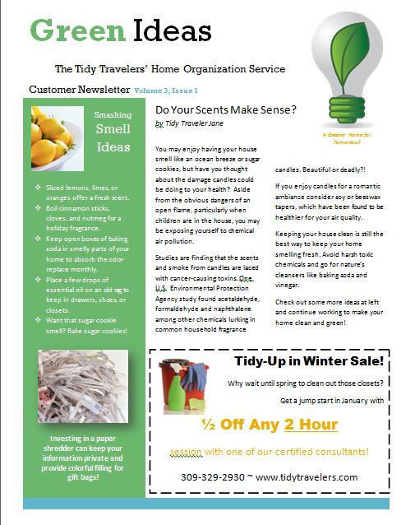
Green Ideas Customer Newsletter
A Learning
Microsoft Word
Project
By K. Geigner

Slide 2
Video 1
Set the ruler to show.
Set the theme “Module”
Create the large green box.
At the end of this video your paper will look like this:

Slide 3
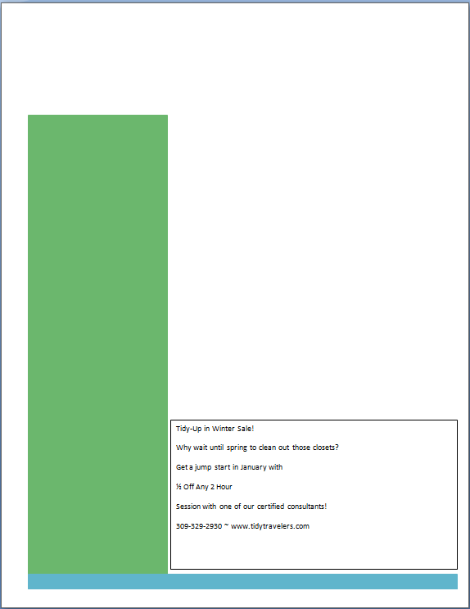
Video 2
Add the blue box at the bottom
Insert the coupon text box
Type the coupon text
At the end of this video your paper will look like this:

Slide 4
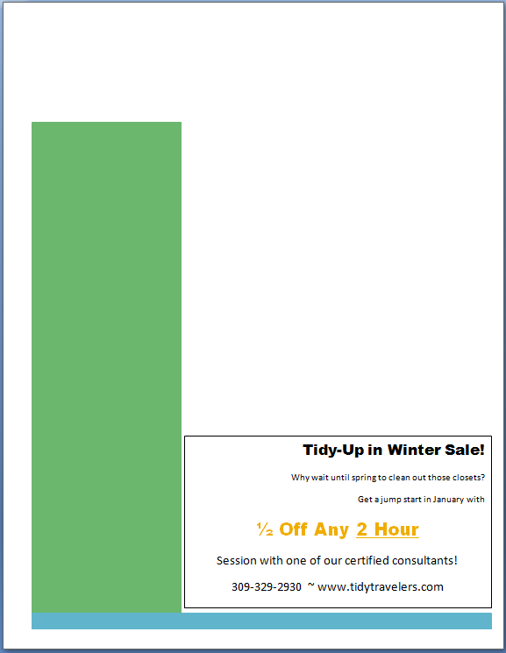
Video 3
Format the text in the coupon box.
Right Justify text.
Center text.
Underline text.
At the end of this video your paper will look like this:

Slide 5
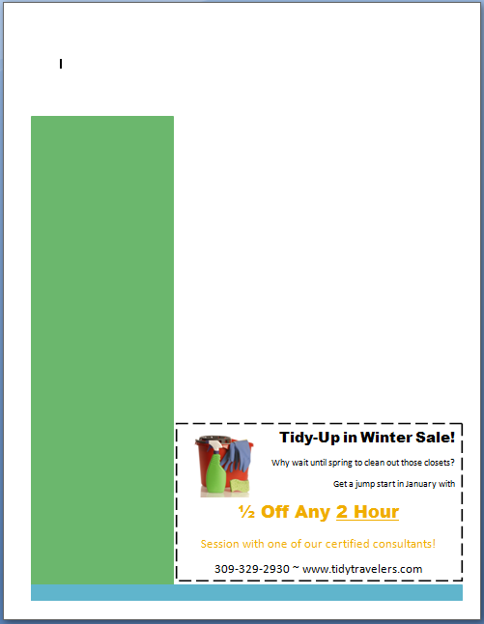
Video 4
Insert an image.
Change text box border.
At the end of this video your paper will look like this:

Slide 6
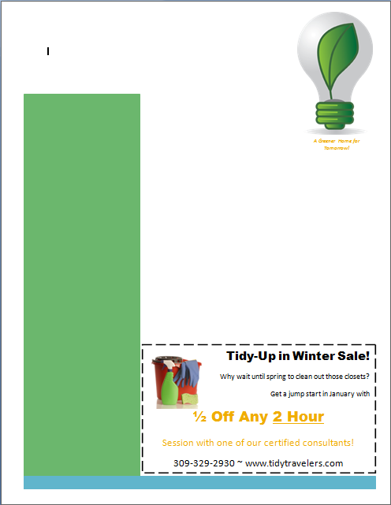
Video 5
Insert an image.
Edit the size of the image.
Insert an image caption.
Use italics on font.
At the end of this video your paper will look like this:

Slide 7
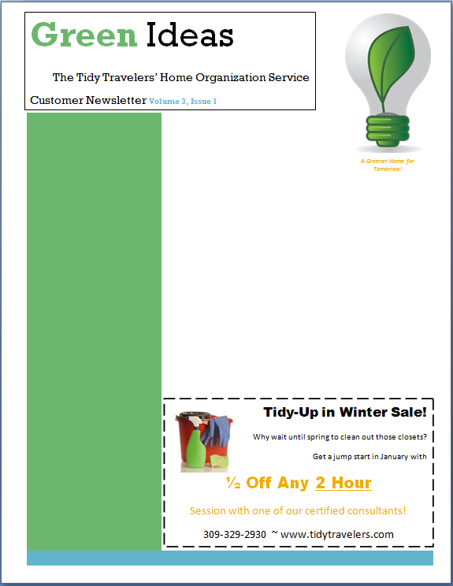
Video 6
Add a text box.
Format text.
Using bold text.
Changing font.
Changing font size.
Changing font color.
At the end of this video your paper will look like this:

Slide 8
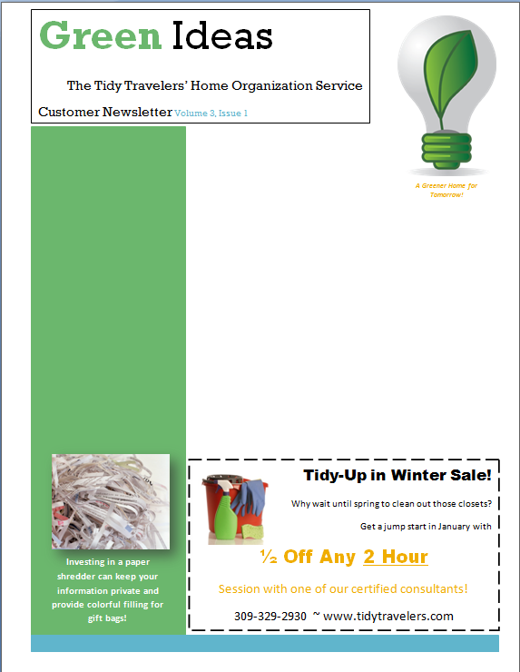
Video 7
Add a text box.
Formatting text.
Changing the box fill.
Changing the box outline.
Centering text.
Adding a picture.
Adding picture effects.
At the end of this video your paper will look like this:

Slide 9
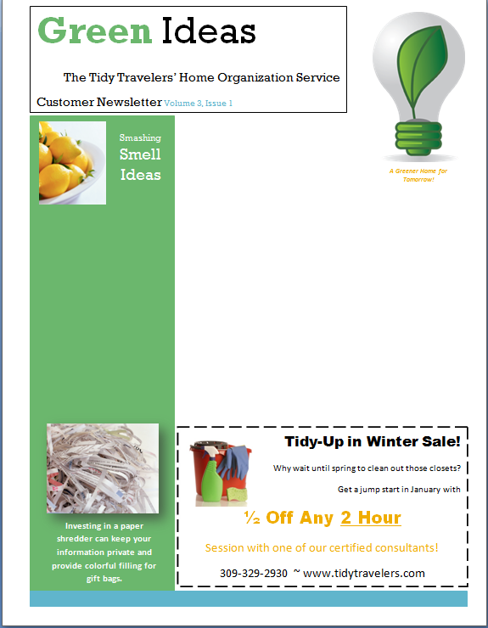
Video 8
Add a text box.
Formatting text.
Changing the box fill.
Changing the box outline.
Centering text.
Adding a picture.
At the end of this video your paper will look like this:

Slide 10
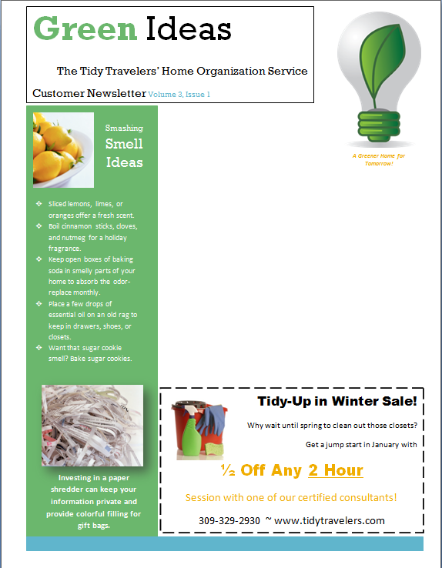
Video 9
Adding decorative bullet points.
At the end of this video your paper will look like this:

Slide 11
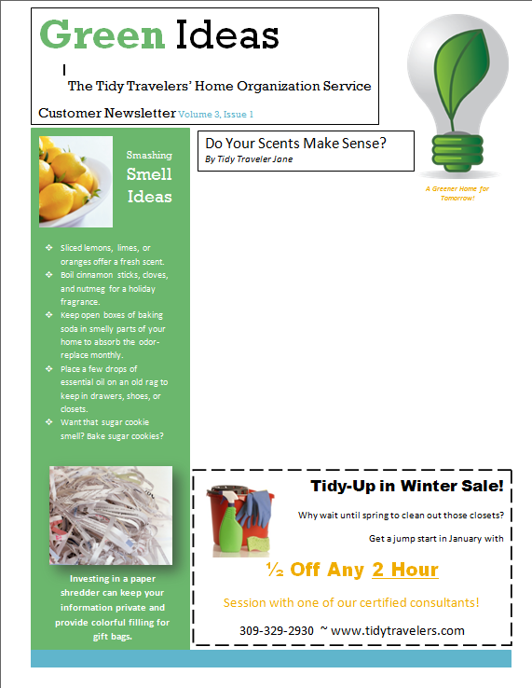
Video 10
Adding a text box.
Changing the text spacing.
Using italics.
At the end of this video your paper will look like this:

Slide 12
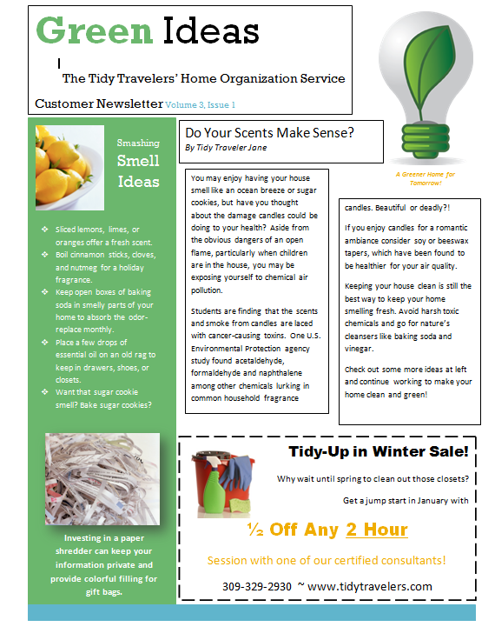
Video 11
Linking text boxes.
At the end of this video your paper will look like this:

Slide 13
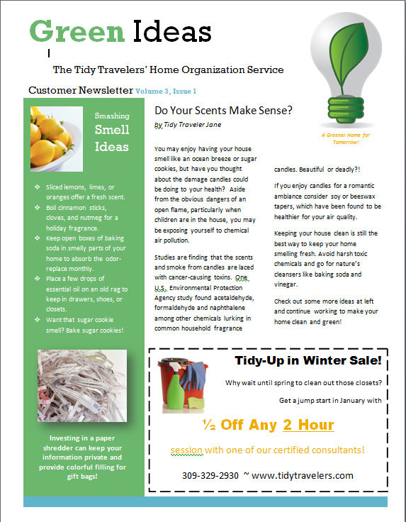
Video 12
Editing!
Removing text box borders.
At the end of this video your paper will look like this:

Slide 14
When you are finished.
Did you have a friend check your work?
Did you have a teacher make suggestions?
Did you compare your copy to the original hard copy?
Great! You can email me your finished word document. You do not need to print it.
If you aren’t sure how to email an attachment please raise your hand and a teacher will help you.

